Slide 1
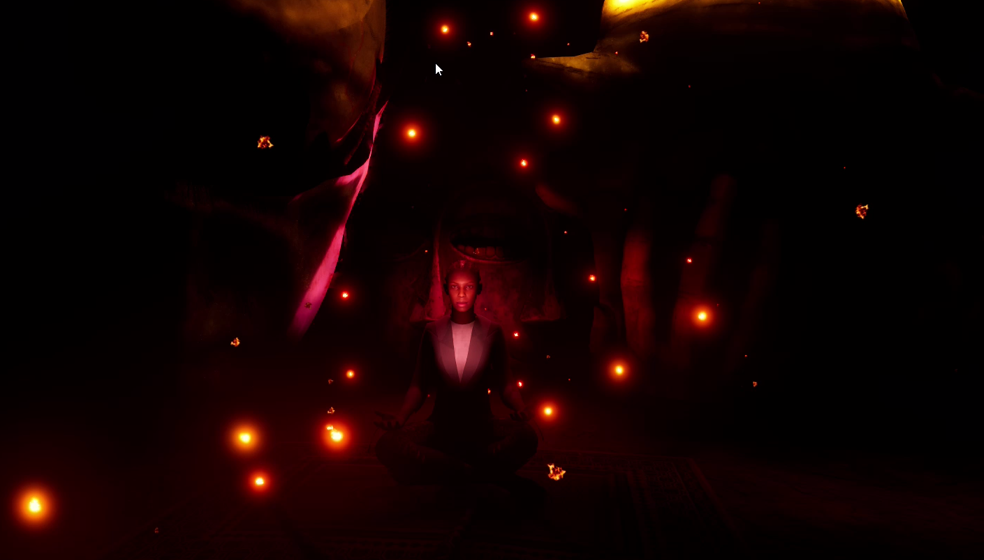
STARTS BLURRY -
A HEART BEAT IS HEARD AS IT UNBLURS REVEALING THE IMAGE

Slide 2
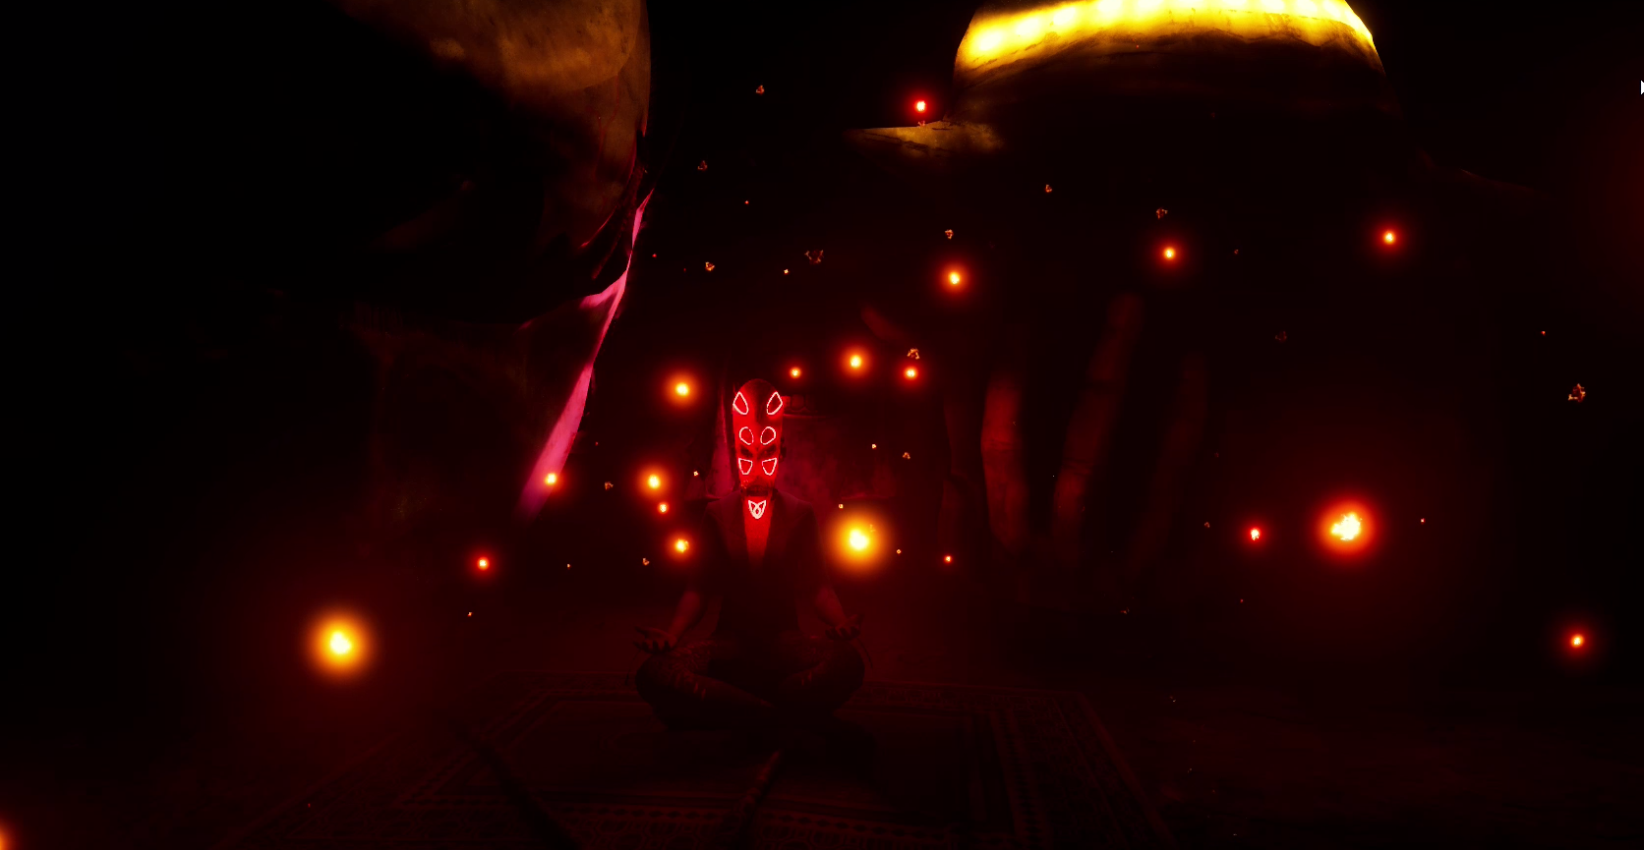
Find a nice transition for text – cant find an AI voice that works so no voice
Create a transition between the girl with the mask and without – keep it short no need to play the whole clip
Daughter

Slide 3
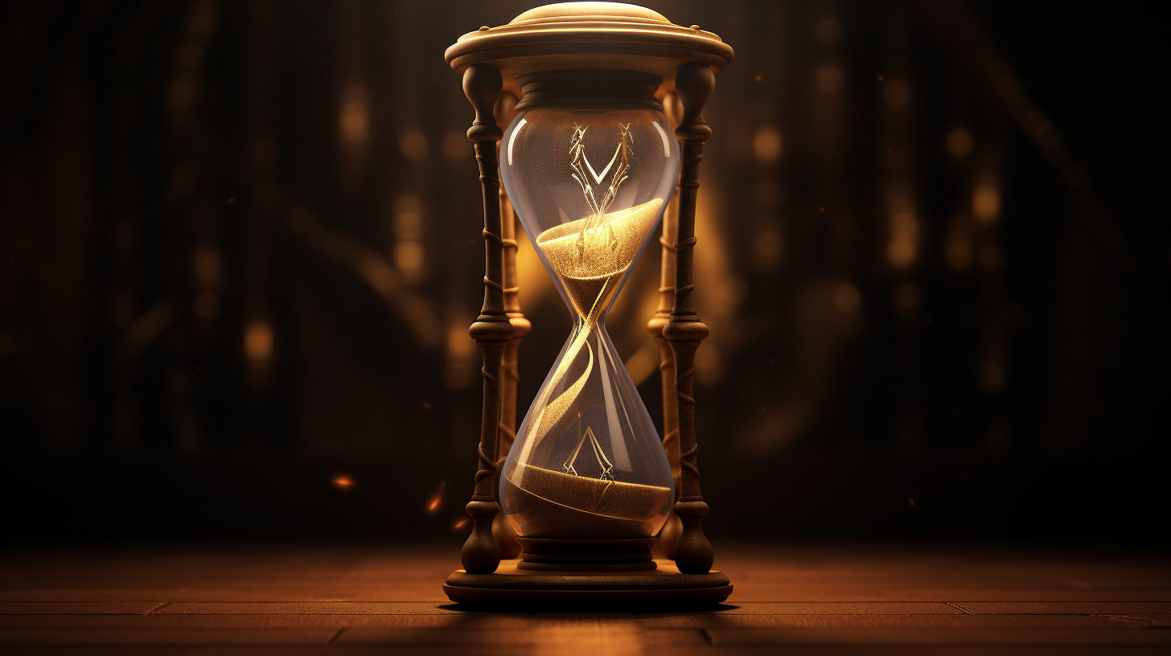
Alternate very quickly between images of the glass and the chick sitting
The effect is meant to feel like it’s a flashing distortion
Start playing the music

Slide 4
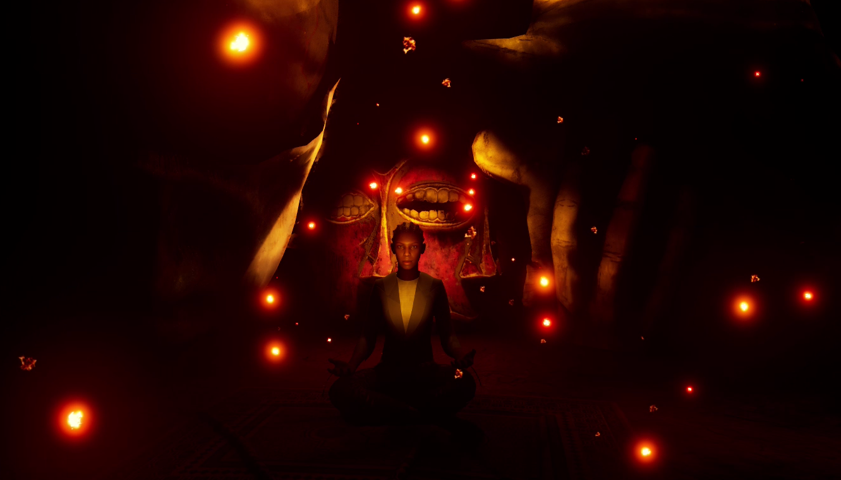
Prepare

Slide 5
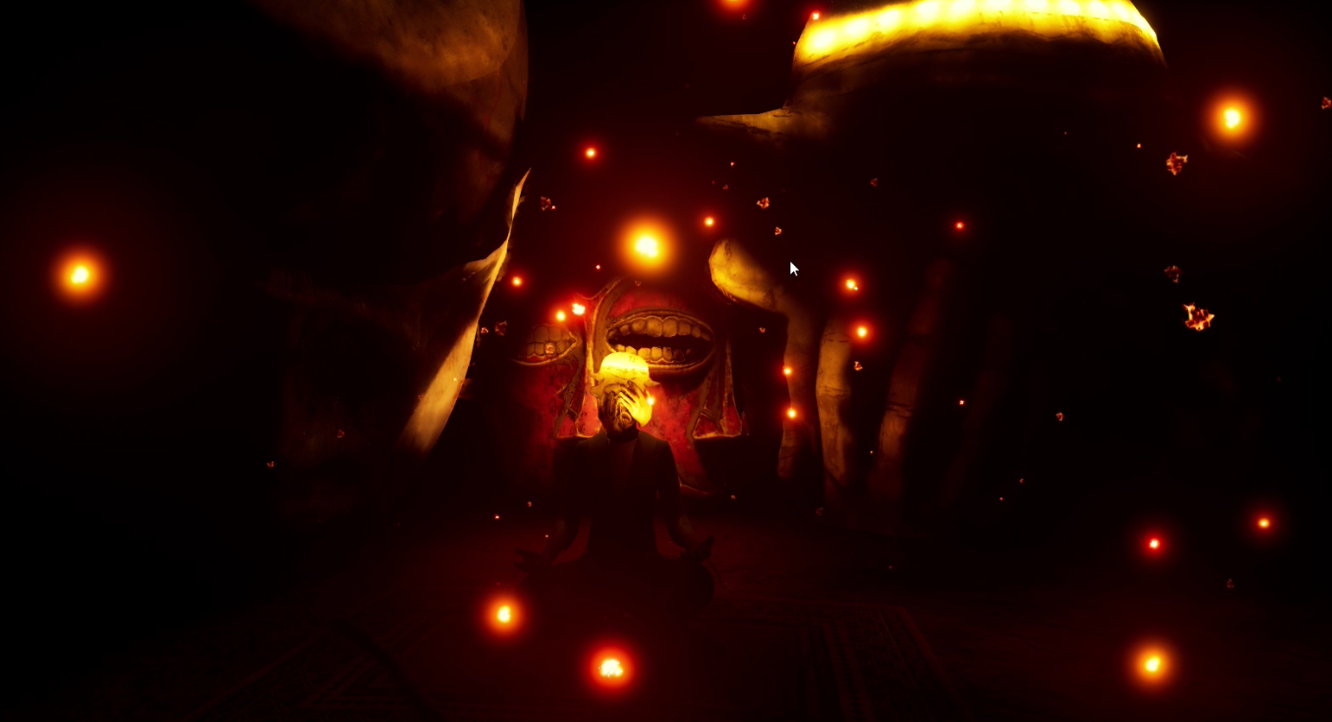
Prepare

Slide 6


Slide 7
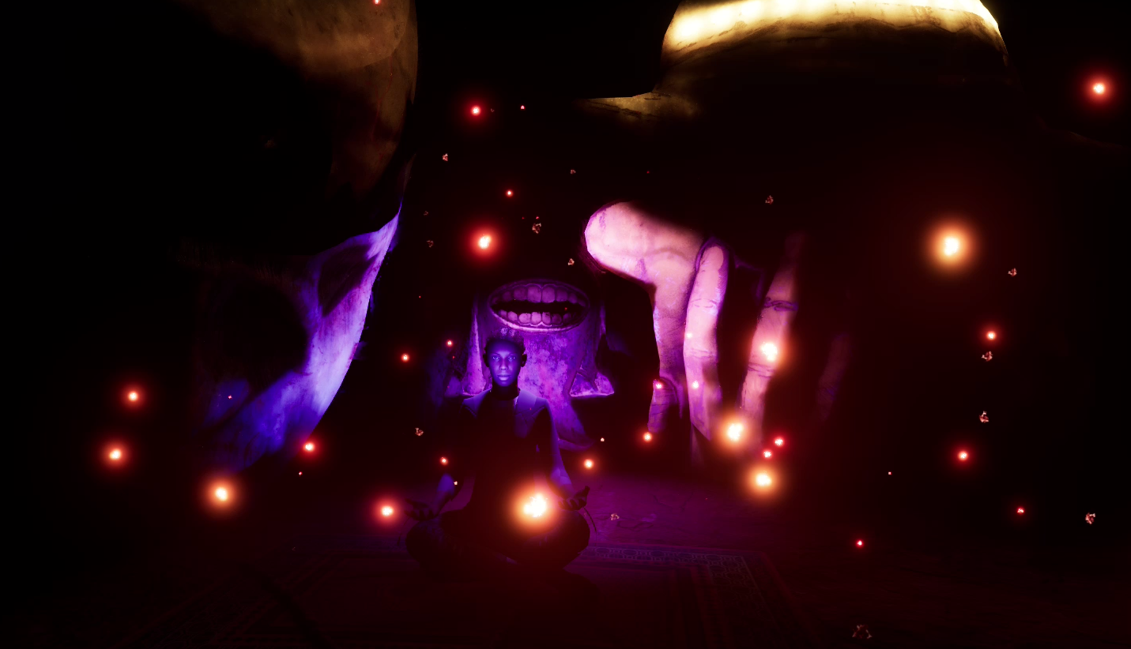
Guilt

Slide 8
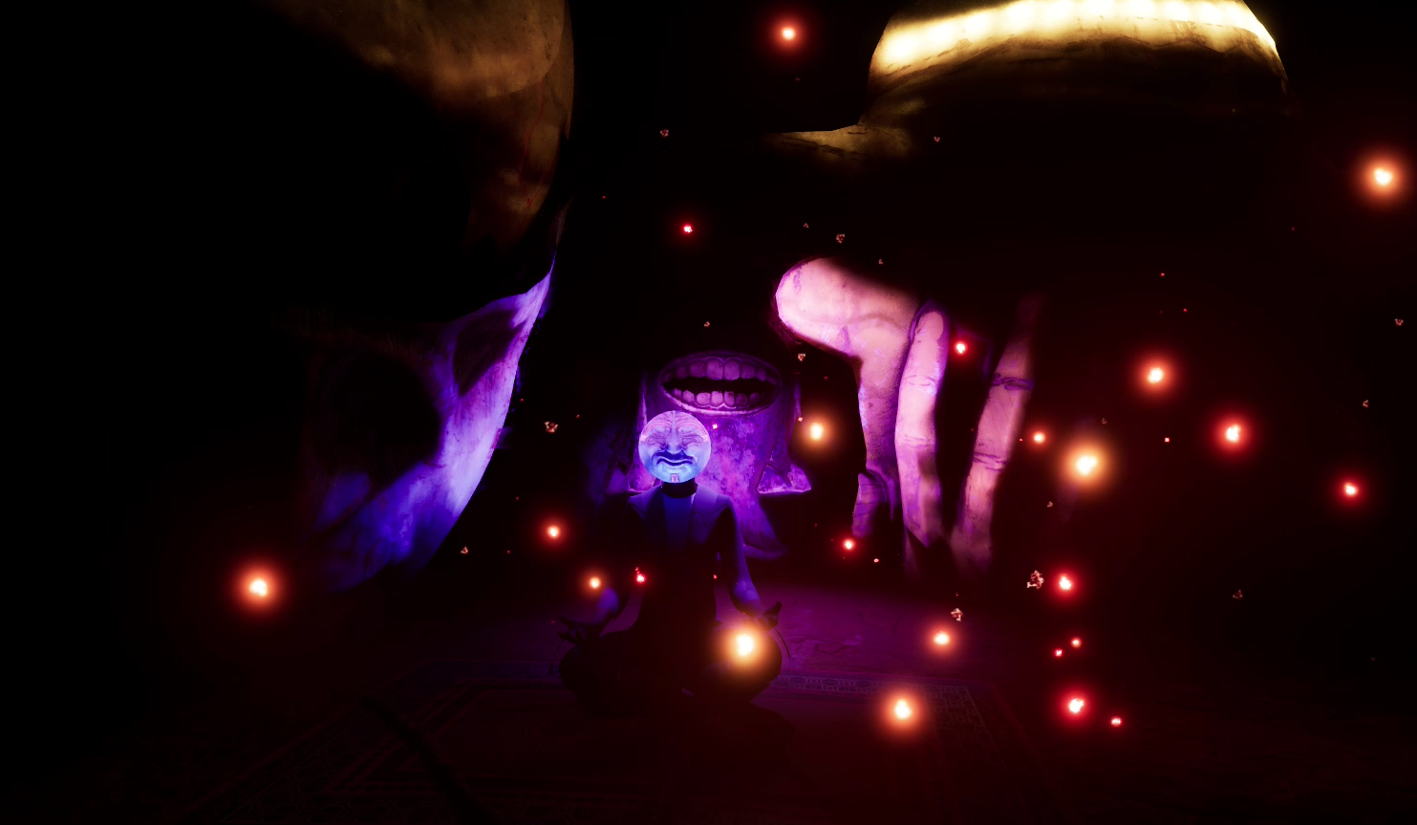
Guilt

Slide 10
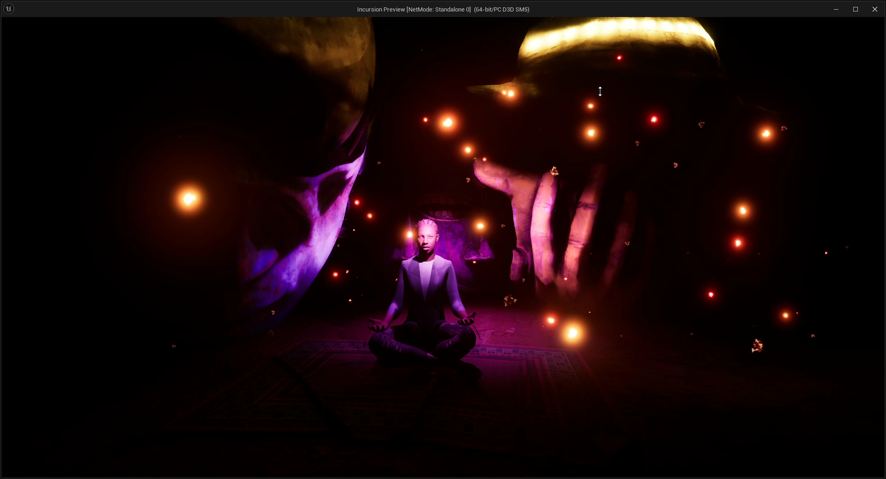
Is paid

Slide 11


Slide 12
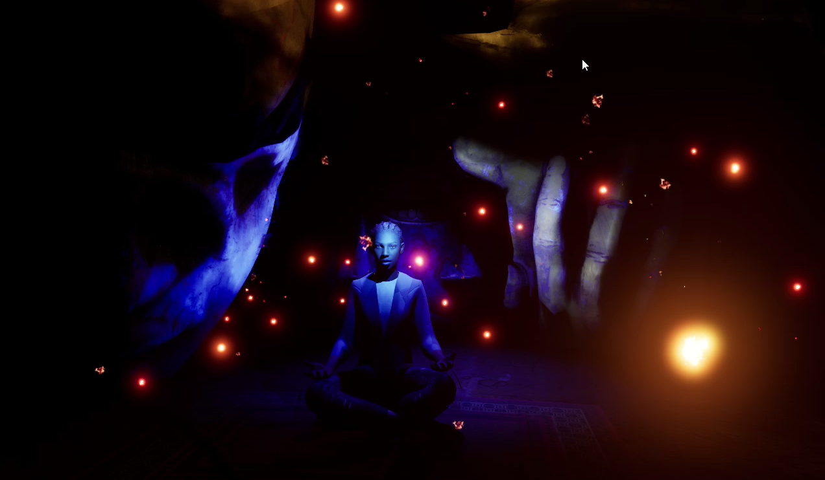
With

Slide 13
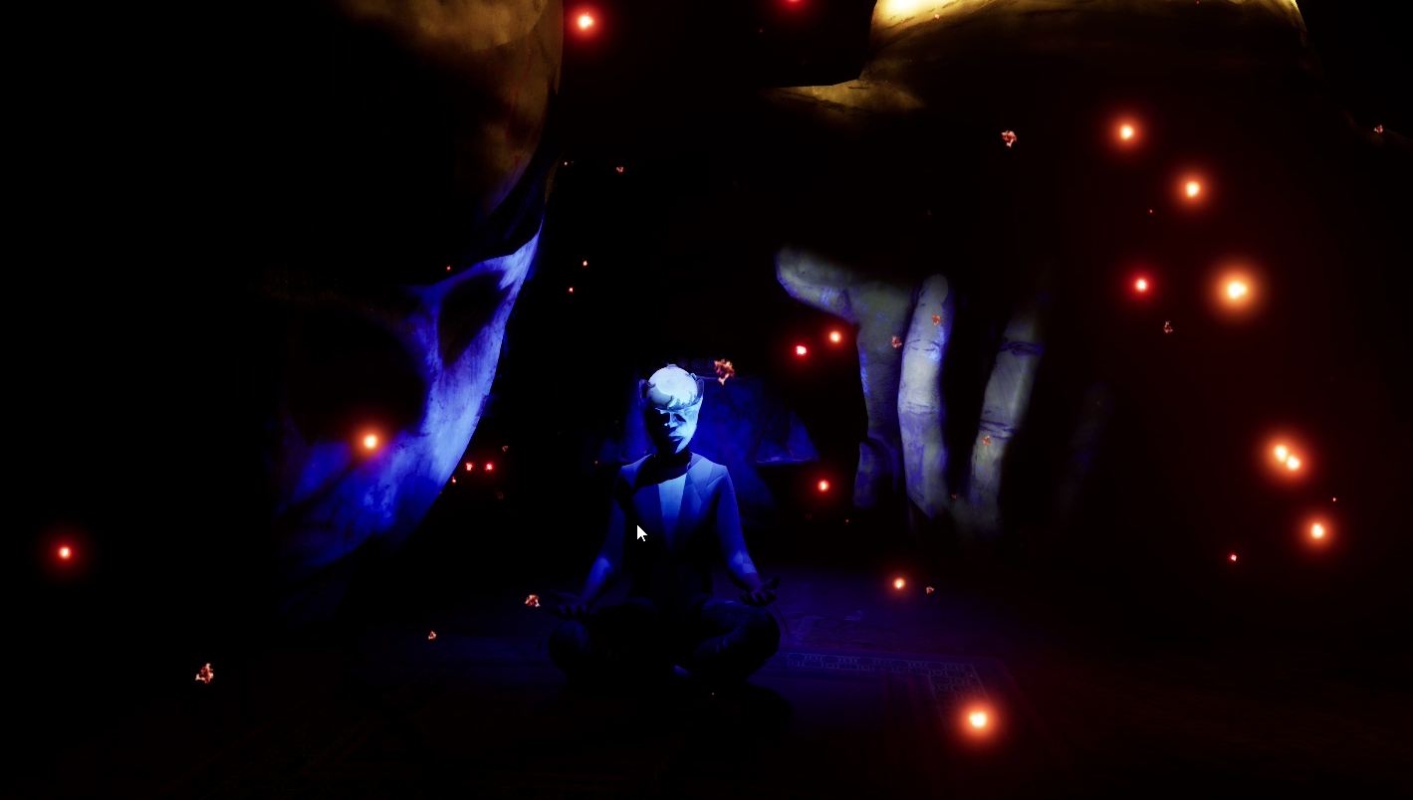
With

Slide 15
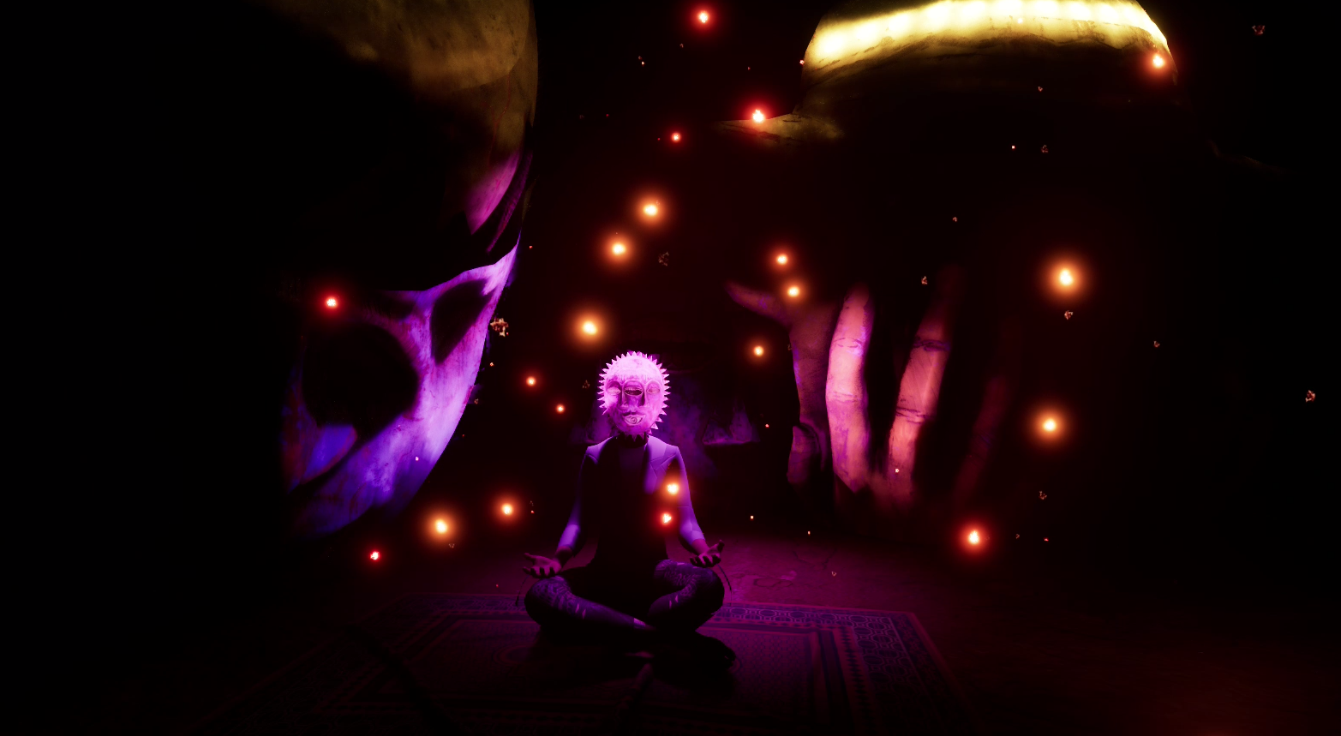
Quickly transition between all the clips with the masks on
pain

Slide 17
PLAY THE START SCREEN VIDEO

Slide 18
After the start screen transition between these clips focusing on showing the change in mirrors and interactions
Mirror, 1, 2, 3,4

Slide 19
FLIGHTCLIP2 0.03 – 0.07
FLIGHTCLIP1 0.05 – 0.09
FLIGHTCLIP3 0.00 – 0.04
FIGHT1 0.09 – 0.14
FIGHT2 0.08 – 0.16
FIGHT5 0.56 – 1.04
Don’t speed up too much the sound becomes funny

Slide 21
The

Slide 23
Cycle

Slide 25
Begins

Slide 27
Again

Slide 28
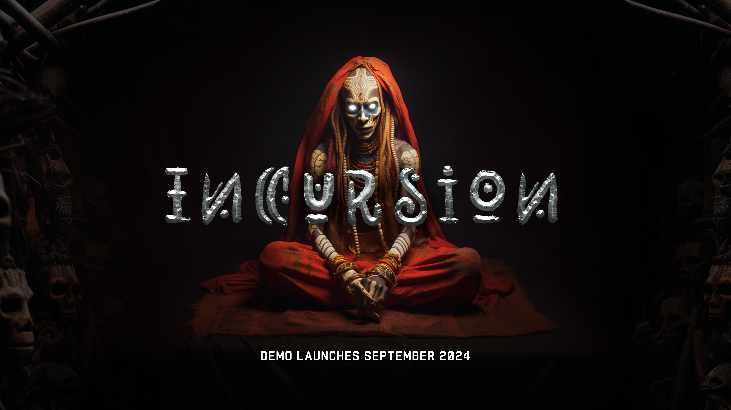
Again
CHANGE THIS TO DCEMBER 2024

